Slide 1

Student Branch Chapter @ USF
Introduction to Python graphs and math
Software Lead: Zarina

Slide 2

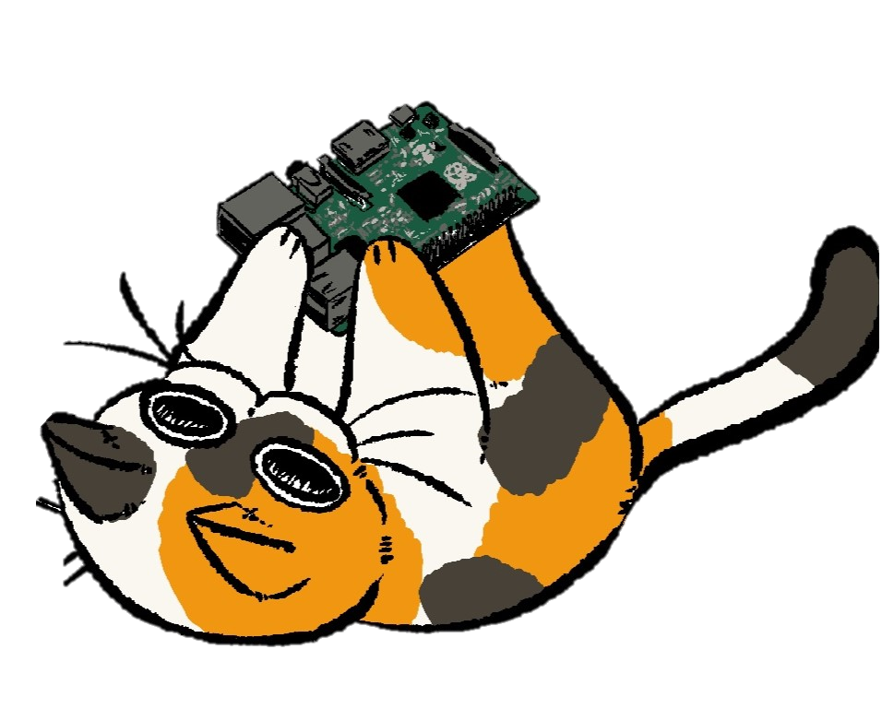
Check in! Support us

Slide 3

Follow Us
Discord
LinkedIn
Instagram
Bulls Connect
GitHub

Slide 4
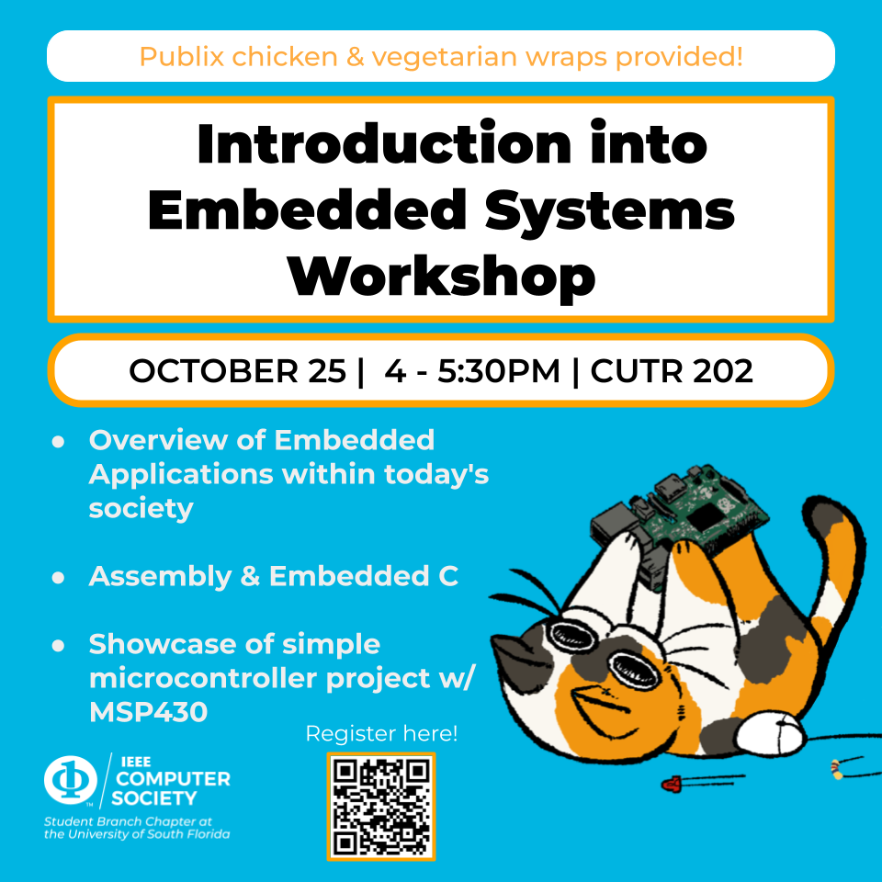

Next workshops ☺ !

Slide 5

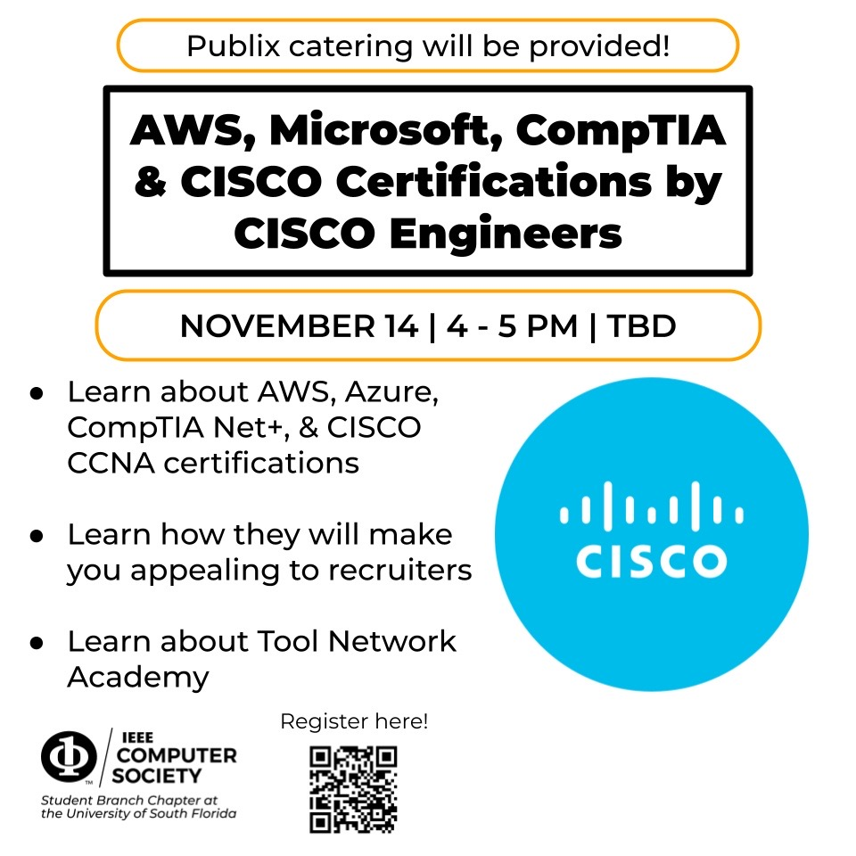
Next workshops ☺ !

Slide 6
By the end of this workshop, you will learn:
Basics of Python
Using Google Colab
Do integrals, derivatives, and differentials using NumPy and SciPy
Do graphs using Matplotlib

Slide 7
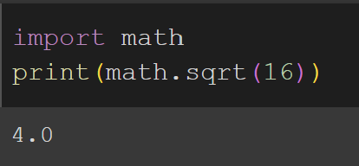
Basics of Python
Python is beginner-friendly but there are some things that you need to know:
There are 4 built-in types of data: string, integer, float, and boolean.
Simple math operators: +,-, *, /, ** (x**2= x^2)
Functions such as print, quad, plot, etc.
You can define your functions using def()
Comments start with #
6. You can import libraries
Libraries in programming are simply collections of pre-written codes that are referred to as modules (files containing code) and functions

Slide 8
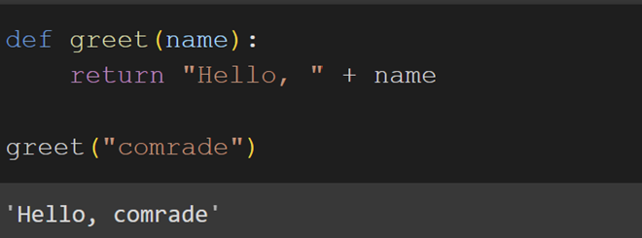
Functions
A function in programming is a reusable block of code designed to perform a specific task. Functions allow you to organize your code, avoid repetition, and make your programs easier to understand, debug, and maintain.
Key Elements of a Function:
Function Definition: This is where the function is created and includes the function name, parameters (if any), and the block of code to be executed when the function is called.
Function Call: Once defined, a function can be called (or invoked) from anywhere in the program to execute the code inside it.

Slide 9
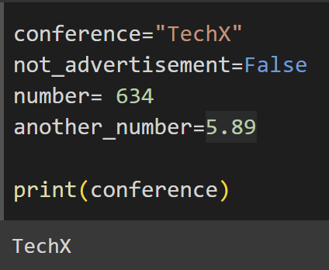
Variables
In programming, a variable is a symbolic name or container used to store data values. Variables allow you to reference and manipulate data throughout your code.
Key Concepts of Variables:
Declaration: When you create a variable, you're declaring it. You assign it a name and a value. This value can change over time, hence the name "variable.“
Assignment: Variables are assigned values using the assignment operator (=)
Data Types: A variable can store different types of data, such as:
Integer (int): Whole numbers, e.g., 25
Float (float): Decimal numbers, e.g., 2.18
String (str): Text, e.g., "Hello“
Boolean (bool): True/False values
List, Tuple, Dictionary, etc.: More complex data types like collections.
Variable Naming: Variable names must start with a letter or underscore but cannot start with a number. They can contain letters, numbers, and underscores, but no spaces. Variable names should be descriptive to make your code more readable, e.g., total_score instead of x.

Slide 10
What is NumPy and SciPy
NumPy and SciPy are both popular Python libraries used for scientific computing, but they serve slightly different purposes.
NumPy (Numerical Python) supports large, multi-dimensional arrays and matrices and a collection of mathematical functions to operate on these arrays efficiently.
Efficient handling of large datasets and numerical computations.
Supports array operations, linear algebra, and random number generation.
Core to many data science and machine learning workflows because it allows element-wise operations on arrays and matrices with high performance.
SciPy (Scientific Python) builds on top of NumPy and provides additional functionality for scientific computing.
Offers advanced mathematical, engineering, and scientific functions, including optimization, integration, interpolation, and statistical tools.
Designed for more complex scientific and technical computations, like solving differential equations and performing signal processing.

Slide 11
What is Google Colab
Google Colab (Collaboratory) is a free, cloud-based platform provided by Google that allows you to write and execute Python code directly in your browser. It is particularly popular for machine learning, data analysis, and deep learning tasks.
Key Features:
Free GPU/TPU: Access to powerful hardware like GPUs and TPUs for faster computation.
Jupyter Notebook Environment: It uses a familiar interface similar to Jupyter Notebooks, making it easy to write and run Python code interactively.
Cloud Storage: You can save and share your work easily using Google Drive.
Library Support: Pre-installed popular libraries like TensorFlow, NumPy, and SciPy.
Collaboration: Multiple users can work together on the same notebook in real-time.
Colab is widely used in education, research, and for prototyping machine learning models without needing complex setups.

Slide 12

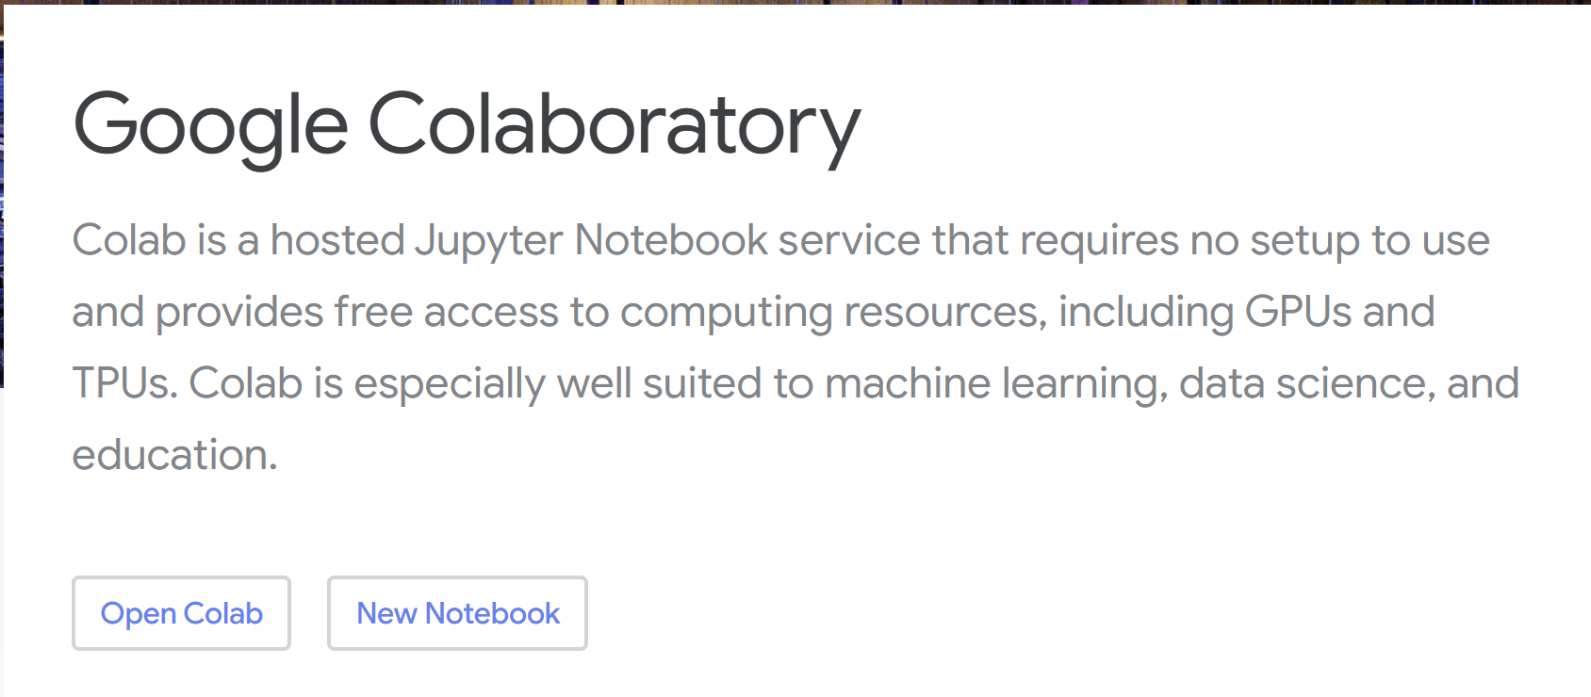
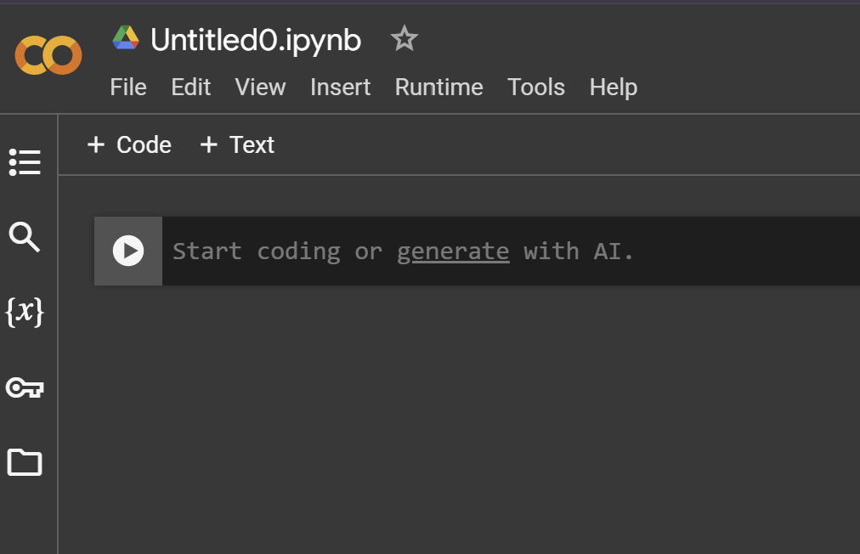
Setting up
WE DON’T NEED TO DOWNLOAD ANYTHING!
The only thing we need is Google Colab and Google Disc.

Slide 13
How to Use Google Colab
Once you log in to your Google account you will have the same window
Blue- area for code
Red-adds space to code
Green- run the code
Orange-file title, you can change it

Slide 14
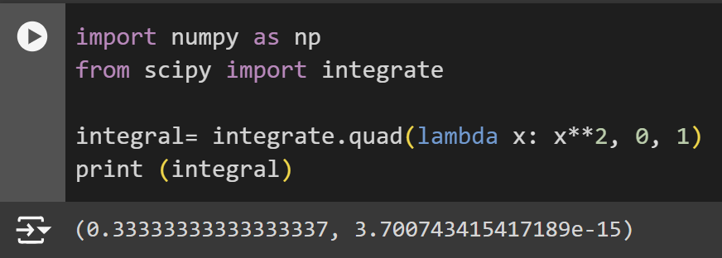
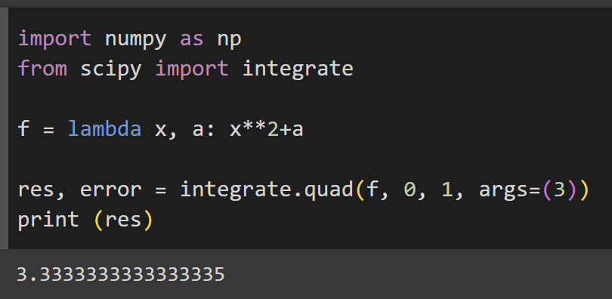
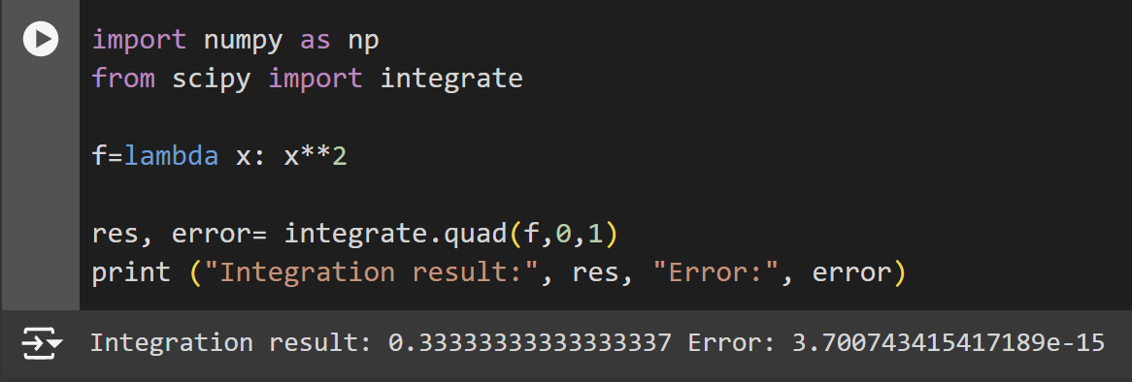
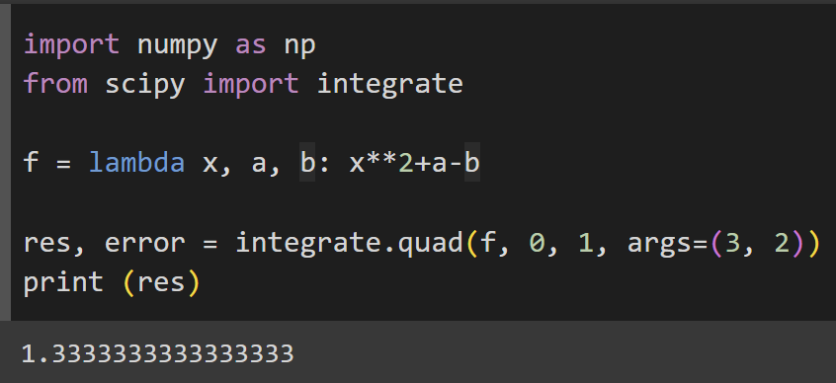
Let’s Start. Integrals
Here we also need to specify what we need from NumPy. The second value is the error
quad(function, lower limit, upper limit, arguments (optional), etc(optional))

Slide 15
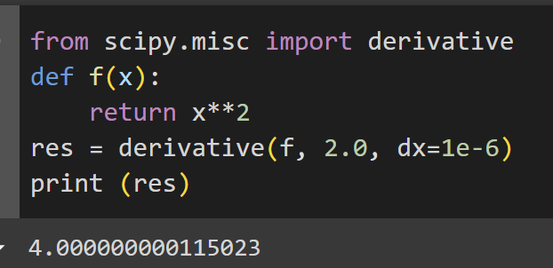
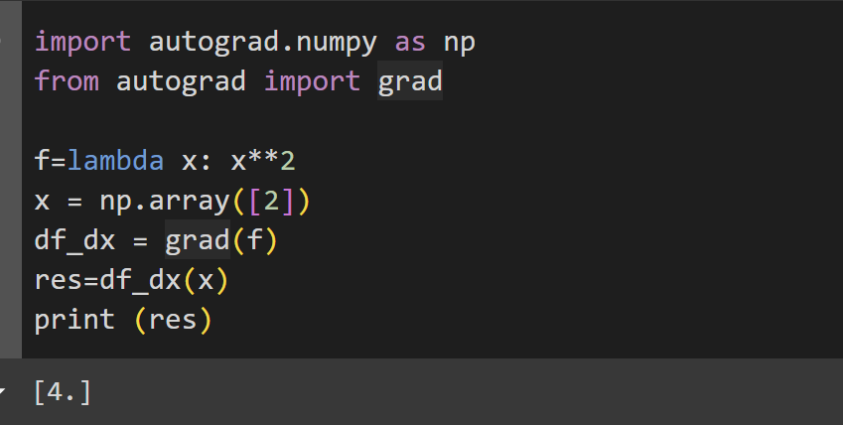
Differentials and Derivatives
Unfortunately scipy.misc will be removed in version 2.0.0
There is also another function grad() and autograd() for differentiation
derivative( function, the given point (x), dx (optional), args (optional), etc)
grad(function, spacing between function values (optional))

Slide 16
MatPlotLib
Matplotlib is a popular Python library used for creating static, interactive, and animated visualizations in Python. It is widely used for plotting 2D graphs such as line charts, bar charts, histograms, scatter plots, and more.
Key Features:
Versatile Plotting: Supports a wide range of plots like line graphs, bar plots, scatter plots, histograms, pie charts, etc.
Customization: Allows full control over the appearance of plots, including axes, labels, legends, colors, and styles.
Integration: Works seamlessly with other libraries like NumPy, Pandas, and SciPy, making it ideal for data visualization in scientific computing.
Interactive: Provides interactive plotting capabilities in Jupyter Notebooks (using %matplotlib inline) and other environments.

Slide 17
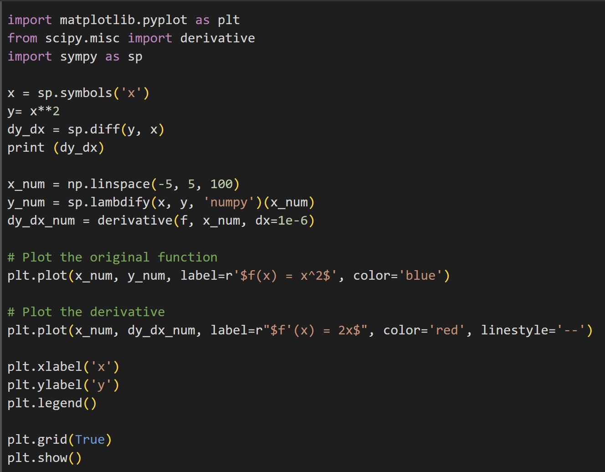
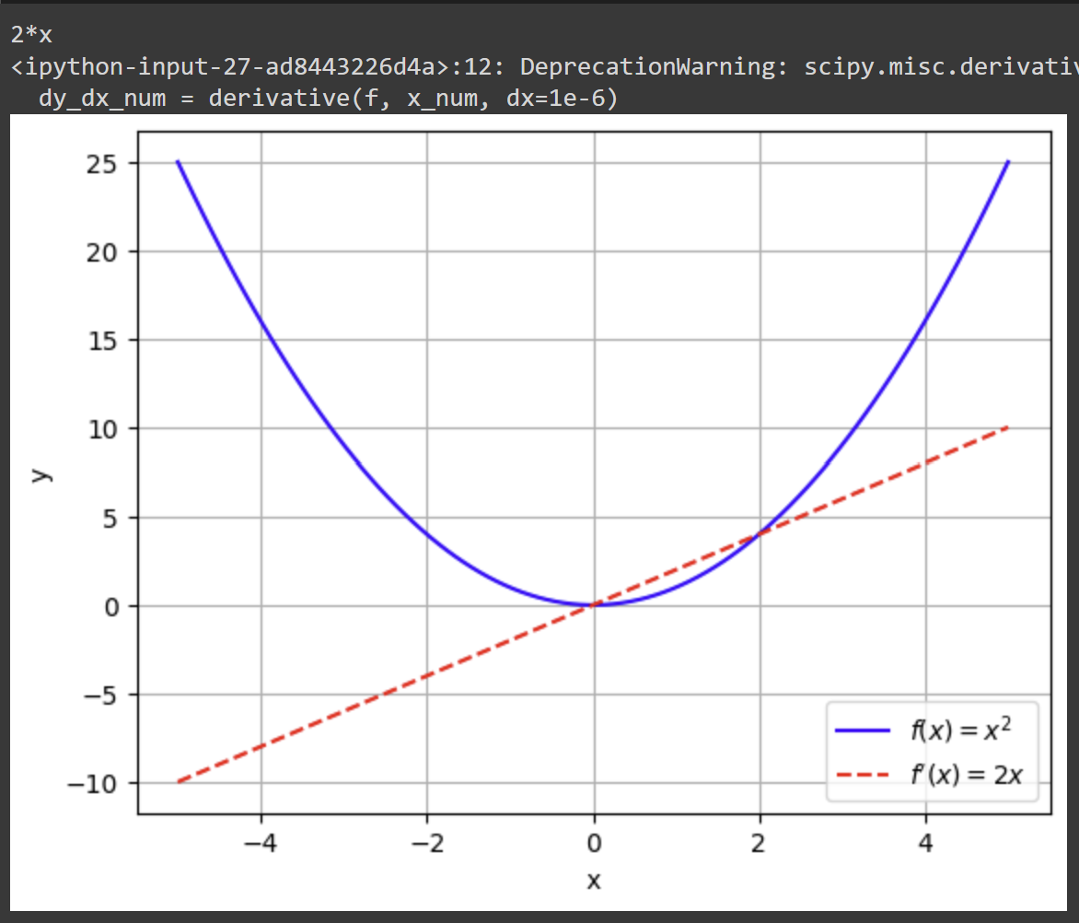
Graphs

Slide 18
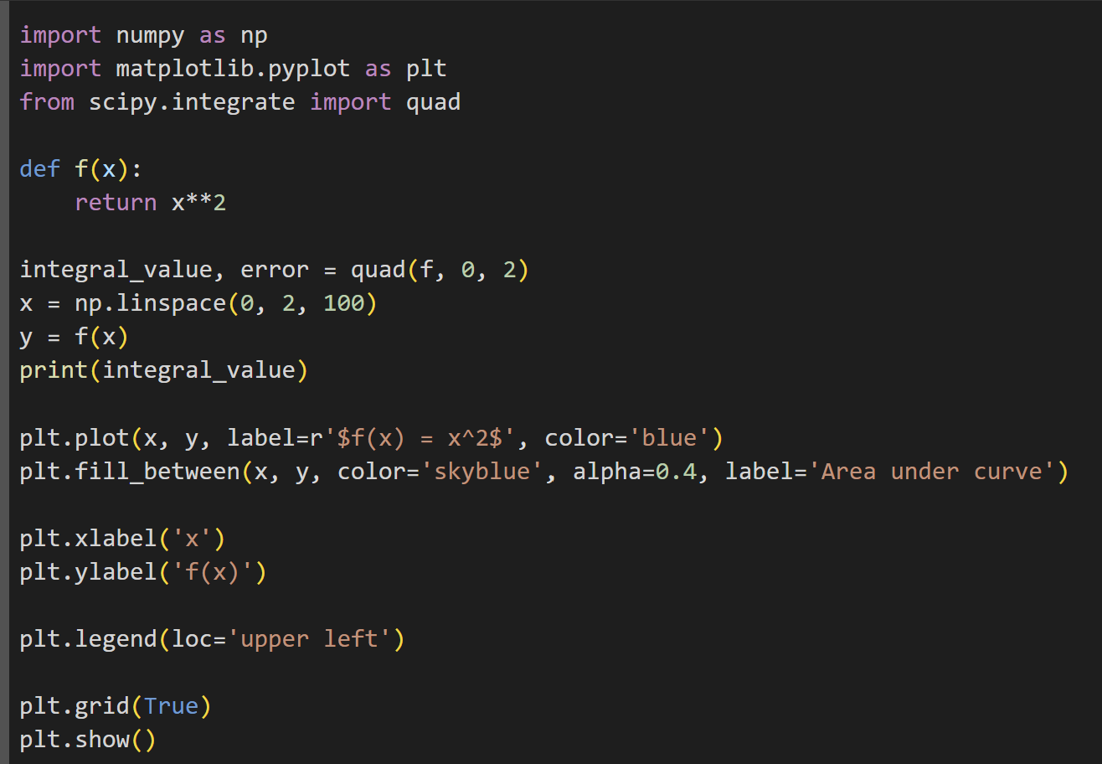
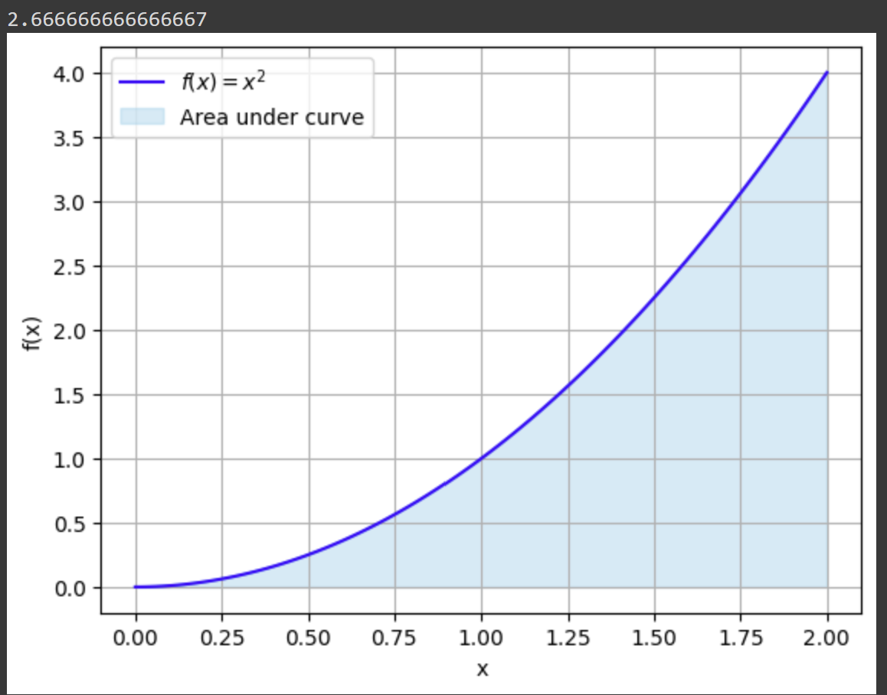
For Integrals

Slide 19

Questions?

Slide 20
Useful Sources
NumPy
MatLab and NumPy (detailed guide for MatLab users with the table of equivalences)
SciPy
MatPlotLib
Google Colab Notebooks

Slide 21
Your action items + Next workshop ☺ !
Actions Items:
Upload your learnings today on LinkedIn and resume
Drop your suggestions in the poll
Make sure to network with folks around you
And join us in our next workshop

Slide 22
Next workshops ☺ !

